Slide 1
HBASE
Not perfect.
guide
2014. 10. 31
Operation Group (SC _ Intranet)
Senior Engineer Donghwan Kim, Assistant Engineer Seunghwan Hwang

Slide 2
Introduction to HBASE
HBase Techs
Operation and management of HBase
HBase Monitoring
HBase Performance

Slide 3

Definition and appearance background
I. HBASE Introduction
HBase: NoSQL Data Base for BigData
- 데이터 양의 증가
- 다양한 형태의 데이터
- 쉽게 저장하고 검색할 필요성 증가
- 기존의 데이터베이스에 한계
- 확장성의 문제
- 구글의 빅테이블 (Big Table)

Slide 4
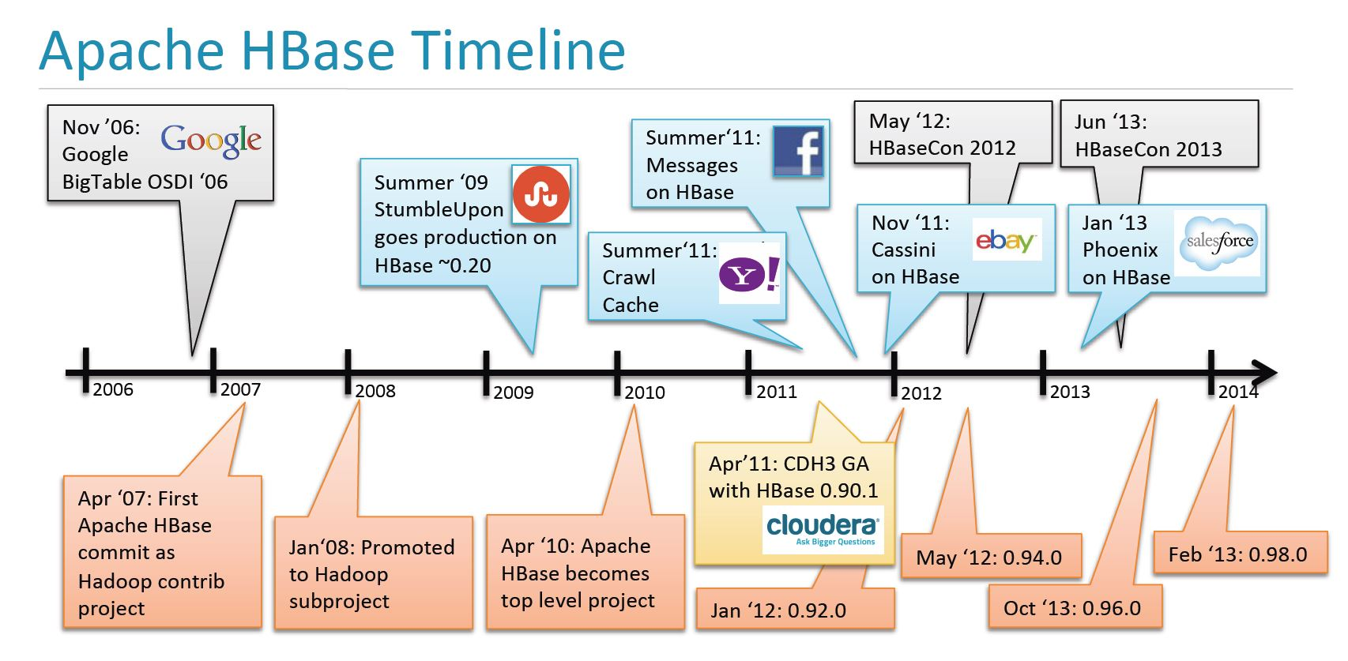
Definition and appearance background
I. HBASE Introduction
HBase의 Timeline

Slide 5
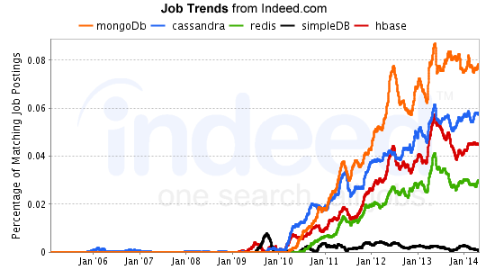
Definition and appearance background
I. HBASE Introduction
NoSQL Job Trends
HBase is the third demand among NoSQL

Slide 6
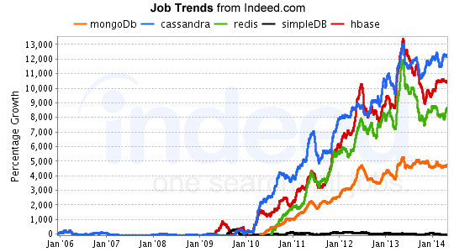
Definition and appearance background
I. HBASE Introduction
Comparison of NoSQL Growth Rate
HBase is growing at a high rate.

Slide 7
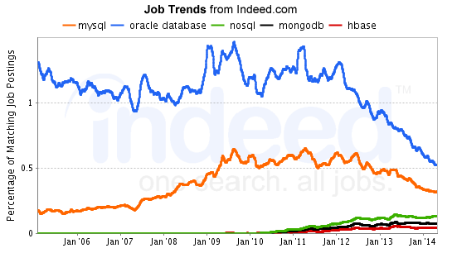
Definition and appearance background
I. HBASE Introduction
DB Job Trends
It is also growing in overall DB demand

Slide 8
feature
I. HBASE Introduction
Column Family Centered: Key based access to specific data cells or sequential to certain ranges of cells
shows excellent performance in approaching→Low latency
1
2
Hadoop based: HFS is used as a physical storage and is easy to process large amounts using mappability
Java-based & Thrift support: Java can implement the code you want, via Thrift
compatible with language
3
Fault Sensitivity: There is a Write-Ahead Log (WAL) that logs all changes in the data
recoverability
4
Map and Multi-dimensional: The map is the core of the Hbase data model and the map in the map
Possible (multi-dimensional)
5

Slide 9
feature
I. HBASE Introduction
Persistent: It is always accessible from entering data into the map to deleting it.
It means that you have to do and maintain the final status.
6
7
Distributed and Sorted: Data is stored distributed but sorted by a key
presence
8
Sparse: No need for all columns to be defined or have values
9
Excellent Scalability: You can add cluster machines and simply expand them, and the system is alive.
Can be done in. (Automatically perform with extension extension)
Provides server-side connections, implements flexible secondary indexing solutions, and provides filters to provide a network
Reduce the amount of data transmitted through
10

Slide 10
Compare with existing relational DB
I. HBASE Introduction
 | RDBMS | HBase
relational / non-relational | relational type | non-relational type
data storage | Centralized | Distributed
query language | SQL | get/put/scan 등
maximum data size | number TB | number PB
Index | arbitrary columns | Rocky only support
read / write throughput | 1,000 per second. | 1 million cases per second.
transaction guarantee | multiple row ACID | single low guarantee

Slide 11
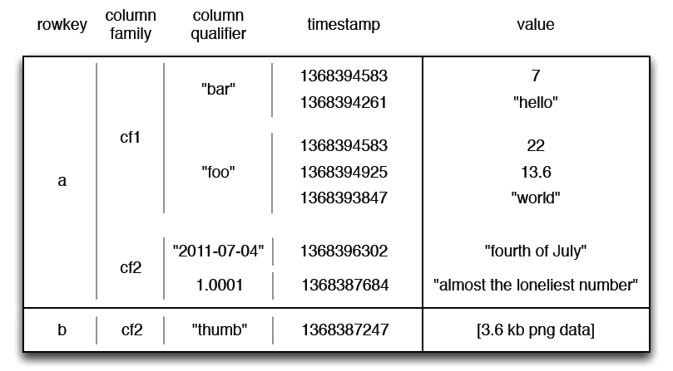
data model
I. HBASE Introduction
Schema: Data access through Row key, Column Family, Column Qualifier, Time Stamp

Slide 12
data model
I. HBASE Introduction
JSON(JavaScript Object Notation) 활용
[
"a" : [{
"cf1" : [
{"bar" : [
{“value”: “7”, “timestamp”, “1368394583”},
{“value”: “hello”, “timestamp”, “1368394583”}
]
},
{"foo" : [
{“value”: “22”, “timestamp”, “1368394583”},
{“value”: “13.6”, “timestamp”, “1368394583”},
{“value”: “world”, “timestamp”, “1368394583”}
]
}]
},
{
"cf2" : [
{"2011-07-04" : {“value”: “fourth of July”, “timestamp”,”1368396302”}},
{“1.0001" : {“value”: “almost the loneliest number”, “timestamp”,”1368397684”}}
]
},
"b" : {
"cf2" : {
"thumb" : {“value”:”[3.6 kb png data]”, ”timestamp”,”1368387247”}
}
}
]
※ Programming expression: SortedMap < RowKey, List < SortedMap < Column, List < Value, Timestamp > > >

Slide 13
data model
I. HBASE Introduction
Row key
The row key is unique and can only be used once
- Updated using the existing row key
All loads are always pre-arranged based on the row key (in descending order)
ex) row-1
row-10
row-11
row-2

Slide 14
data model
I. HBASE Introduction
Column Family
Core of Hbase data model
Allow data to be categorized semantically or by topic
Applying specific functions such as compression or memory resident
In charge of grouping data, you need to define first when creating a table
Multiple column families can exist in one row
Hbase tuning is done in column family units.
All columns in the column family are saved as Hfiles
Names must consist of outputable characters
This name is used as the directory name in the store
Do not change too many or frequently

Slide 15
data model
I. HBASE Introduction
Column Qualifier
Columns are the units of data that make up the column family
Access data through column quality
get testtable, ‘a’, ‘cf1:bar’
No limit on number, type, and length

Slide 16
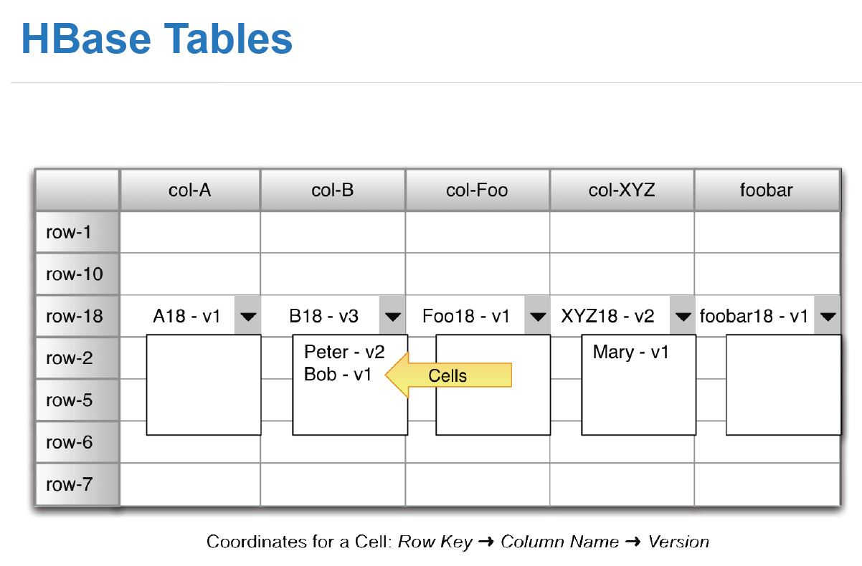
data model
I. HBASE Introduction
Time Stamp
Multiple versions can be stored in each cell
Each version is implemented through a timestamp
Organized in descending order
Long term converted to millisecond
Unix time: UTC standard January 1, 1970
this time
Java System.current.TimeMillis()
Saves up to three versions of one value (default)
Scan and get commands are only the last entered version
attainability

Slide 17
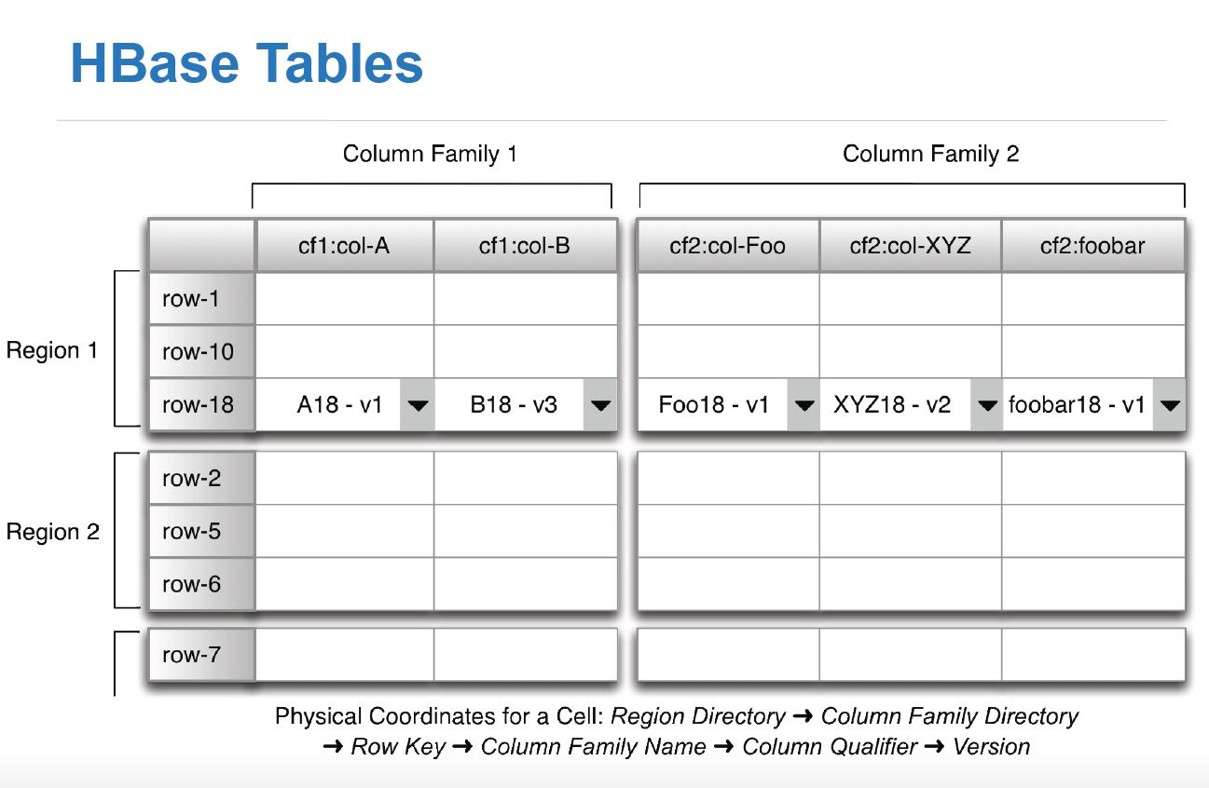
data model
I. HBASE Introduction
Hbase Tables
Singularity: Delete
In HBase, even if the contents of one cell are deleted, they are not deleted immediately.
It remains with the Tombstone mark engraved and can not be viewed.
In order to completely delete it, you have to process it differently.

Slide 18
data model
I. HBASE Introduction
Hbase Tables
Column Family 1
A
B
 | A | B | C
row-a | V(cf1) | V(cf2)
row-b |  | V(cf1)
row-c |  |  | V(cf2)
row-a
row-b
row-c
Column Family 2
B
C
< RDBMS >
< HBase >

Slide 19
data model
I. HBASE Introduction
Example of Next Generation My Single Data Model
Table: Mail Information {MML _ tMail}
RowKey | User ID {userId}, folder ID {fldrId}, mail sequence {mlSeq}
ColumnFamily | Mail information {cd _ d (data)} | Column | Mail ID {mlId}
 |  |  | Mail title {mlTtl}
 |  |  | Mail content summary {mlCnSumry}
 |  |  | Original ID {org Id}
 |  |  | Temporary status {tmpYn}
 |  |  | External part {xtnlYn}
 |  |  | upper mail path [LIST] {uprMlPath}
 |  |  | Receive date and time {rnsDt}
 |  |  | header date and time {hdrDt}
 |  |  | mimeStrctVal}
 |  |  | Reception Type Code {rnsTypeCd}
 |  |  | Mail type code {mlKndCd}
 |  |  | Whether to request an answer {rpldmndYn}
 |  |  | Emergency Priority {urgPrioRnk}
 |  |  | Mail size {mlSz}
 |  |  | Attachment [LIST] {atchFiles} | File ID {fileId}
 |  |  |  | File name {fileNm}
 |  |  |  | File size {fileSz}
 |  |  |  | File type value {fileTypeVal}
 |  |  | Recipient [LIST] {rcvrs} | Recipient address {rcvrAddr}
 |  |  |  | Recipient name {rcvrFnm}

Slide 20
merits and demerits
I. HBASE Introduction
merit
excellent scalability
ensuring consistency of data
Automatic Fault Overcoming and Fault Sensitivity
Atomic processing for one line is possible
Before a process is completed, another processor will access and read and write its memory address.
No action.
Previous version of data value can be managed
Monitoring can be done through web console
Multiple users have parallel access to data
Fast processing speed for large data
Tens of billions of Row→Write ~ 1ms, Read 1~10ms
schematic fluidity
Can develop storage structure according to application

Slide 21
merits and demerits
I. HBASE Introduction
disadvantage
incomprehensibility
unfamiliar column structure
Need to understand multiple programs
failure propagation
Hadoop, use the main keeper together, if there is a problem on one side, the problem spreads on the other side.
Difficult to process transfer
Hotspot issue
Hot region / Cold region
Only certain reversion servers load
performance degradation occurrence

Slide 22
summary
I. HBASE Introduction
NoSQL Data Base for BigData
column family
center
structural
A lot of studying.
necessity
fast, scalable,
big data
easy to process
Related to Region design
problem
possibility

Slide 23
Introduction to HBASE
HBase Techs
Operation and management of HBase
HBase Monitoring
HBase Performance

Slide 24
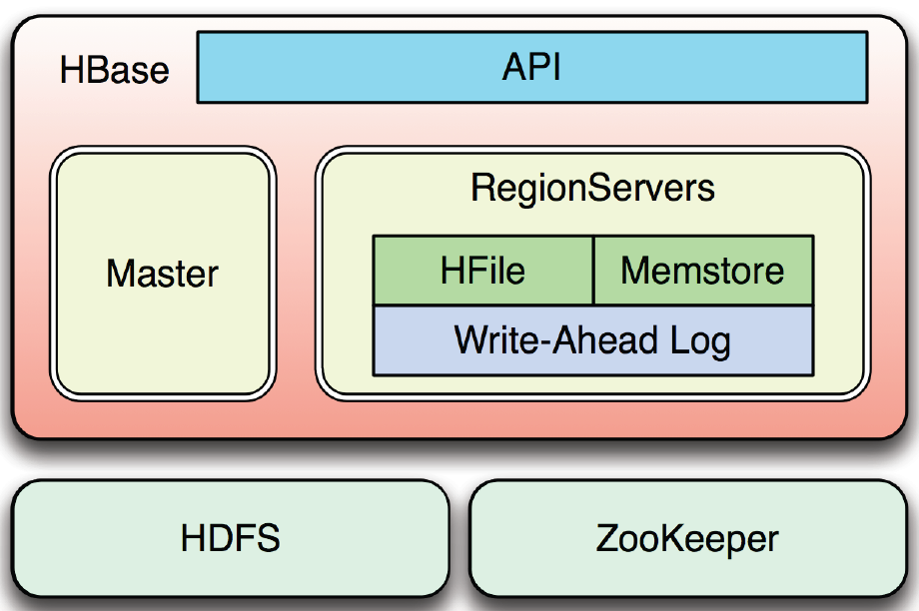
component
Ⅱ. HBASE Techs
HBase consists of Master, API, RegionServer, HDFS, and ZooKeeper.

Slide 25
component
Ⅱ. HBASE Techs
API: There are three types of APIs that can communicate with Hbase.
API
Shell
Thrift
JAVA
API
It can be compatible with Visaba language through Thrift API
※ Others: Map / Reduce, Hive, Pig, etc.

Slide 26

component
Ⅱ. HBASE Techs
HBase Shell
Easy access to HBase with the following command: $. / bin / hbase shell
You can check the list of shell commands and options through help entry
Because it is JRuby based, it can be used by mixing ruby with HBase command
Create, list, put, scan, get, disable, drop, etc.
Run Shell
※ echo “ status ” | bin / hbase shell can also be used like this

Slide 27
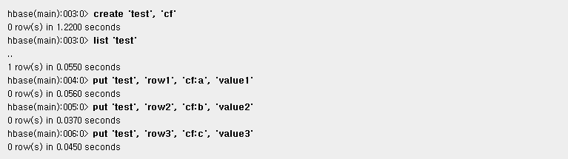
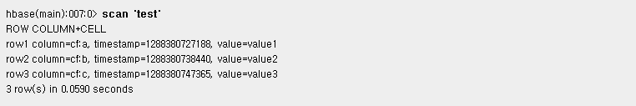
component
Ⅱ. HBASE Techs
HBase Shell
Table creation and data entry
table data scan

Slide 28


component
Ⅱ. HBASE Techs
HBase Shell
Retrieving a row of data
Disabling and deleting tables

Slide 29
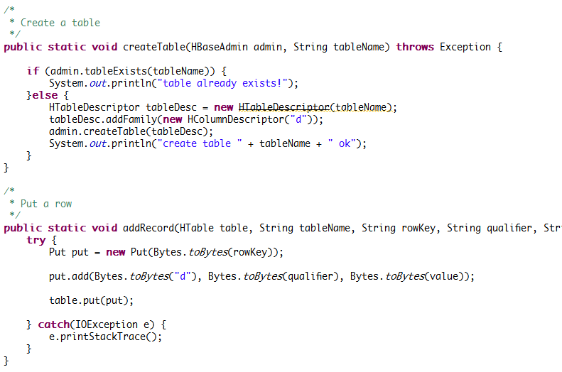
component
Ⅱ. HBASE Techs
JAVA API
table generation

Slide 30
component
Ⅱ. HBASE Techs
RegionServer와 Region
RegionServer has a block called Region.
RegionSever | Region
Among master – slave architectures, slave is called RegionServer Mestore, Hfile, and WAL exist inside Lion management Split, merge, etc. Increase speed through what is called block cache Handling read and write requests for all the leases you are responsible for Clients communicate directly with the reversal server at work | set of adjacent rows Data size limits that can be saved Separate into two repetitions when the limit is reached Report to Zookeeper at the time of separation Can be distributed across many physical servers The number of leases per server should be between 10 and 1000, and the size should be between 1 and 2GB Basic Unit for Scalability and Load Balancing

Slide 31
component
Ⅱ. HBASE Techs
Master
The Master monitors all RegionSever.
Allocation of retransmission to retransmission server (using main keeper)
Load Balance Processing between Legends
Move the replay to a server with plenty of free space
Not included in the path through which the process passes when saving or reading data
Data service not provided
load lightness
Perform schema changes and other metadata tasks, such as creating tables and column families

Slide 32
component
Ⅱ. HBASE Techs
Memstore & HFile
Memstore acts as cache memory
When data is input such as create, put, etc., it is not saved as a file but as a memory called a memory store.
After that, when the data capacity exceeds the set value, the data is flushed to the Hfile.
Limit can be set with hbase.hregion.memstore.flush.size
permanent data storage file
Continuous blocks (the hbase is saved in blocks when saving files)
compressible

Slide 33
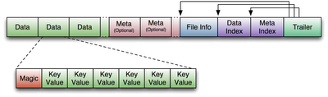
component
Ⅱ. HBASE Techs
HFile
Fixed block is File info, Trailer block
The trailer block stores pointers to other blocks
Data and meta-blocks also exist, and data blocks hold at least one
Each data block has a header called Magic and several key values
Key Value has the following data formats
Key Length | Value Length | [Low Key Length | Low Key | Column Family Length | Column Family Name |
Column Quality | Timestamp | Key Type] | Value
He is much taller than his worth.
Key length and value length values are fixed, so you can access them directly with values

Slide 34
component
Ⅱ. HBASE Techs
Automatic failure recovery of WAL (Write-Ahead Log)
exists for recovery when server fails before storing data stored in Memstore as HFile
All modifications are entered in the log before application
Logging all changes on the reversal server
Automatically moved if all files are saved and no log files are needed
The old log file is deleted after 10 minutes by the master
Deactivation (put performance improvement)
Structure shared by all leases managed by the leases server to which they belong

Slide 35
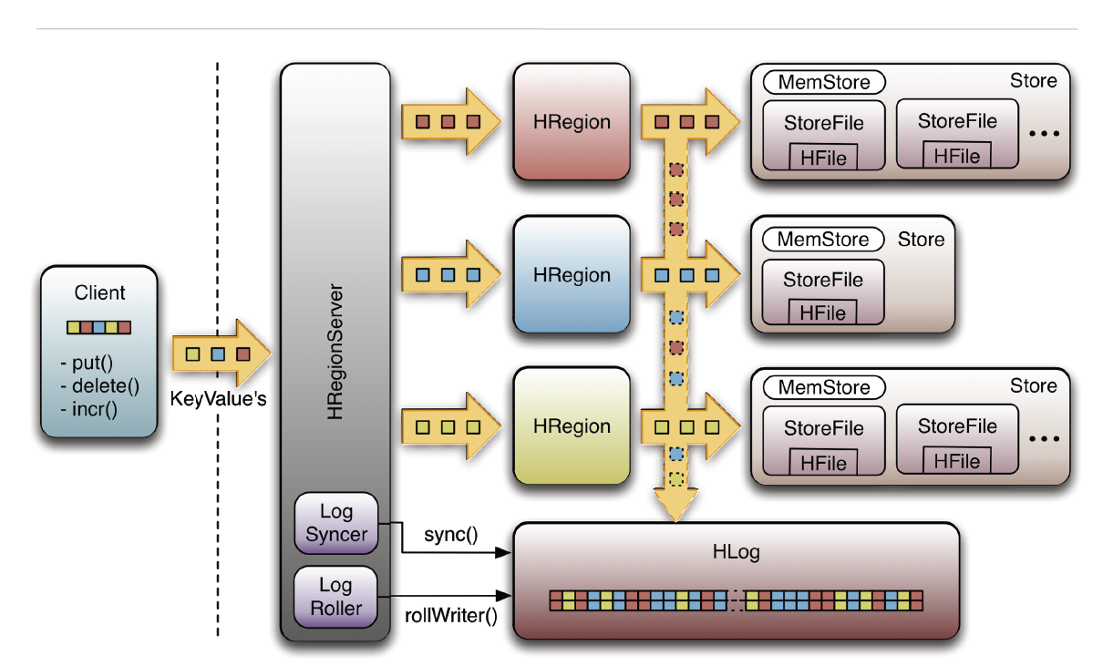
component
Ⅱ. HBASE Techs
The process by which the flow of data change processing is branched between the membrane store and the WAL

Slide 36
component
Ⅱ. HBASE Techs
Class LogSyncer & LogRoller in WAL
LogSyncer | LogRoller
The role of calling sync () method sync (): A method that forces the file system to recognize changes to the log Whenever there is a change according to the flag, the sync () method is called or the change is stored in the reversion server buffer and the Sync () method is periodically called (default 1 second). | Perform in the background The role of switching log files from cycle to cycle (1 hour) The log file currently in use is closed and a new log file is created.

Slide 37
HBase Architecture
Ⅱ. HBASE Techs
General HBase Architecture
Rest/Thrift/Avro Gateway
JavaApp
HBase Shell
HBase
Client
HBase
Client
HBase
Client
odd number configuration
(Usually 3 ~ 5)
Rest/Thrift/Avro Server
Zoo
Keeper
Journal
Node
HBase
Master
HDFS
Required when configuring
Region
Server
Region
Server
Region
Server
Region
Server
Name
Node
Data
Node
Data
Node
Data
Node
Data
Node

Slide 38
operating flow
Ⅱ. HBASE Techs
read operation
Client
Zookeeper
1
2
4
3
HRegionServer
5
HRegion
HStore
6
hbase:
meta
...
HBase
7
...
HRegion
Block
Cache
StoreFile
StoreFile
...
HFile
HFile
...
DFS
Client
HDFS
...
DataNode
DataNode
DataNode
DataNode

Slide 39
operating flow
Ⅱ. HBASE Techs
read operation
1
If the client requests to read, the main keeper ensemble (a separate cluster consisting of the main keeper node)
first approach
2
The server information that manages the meta table that contains the row key you want to read through the main keeper
attainability
3
The name of the server that queries the meta table to manage the reversal with the low key that the client finds
Received (the information is cached and retrieved through block cache)
4
Now you can access the HRegionServer that manages the dictionary directly
5
HRegionServer opens a reversal and creates a corresponding HRegion instance.
6
When HRegion is opened, Hstore according to the settings for each HColumnFamily in each table.
Creates an instance
7
Each HStore instance may have one or more StoreFile instances, which are HFile
It is a lightweight wrapper that wraps up the actual storage file called
Returns the data distributed in HDFS.

Slide 40
operating flow
Ⅱ. HBASE Techs
read path
StoreScanner by combining the data stored in the Memstore with the stored data.
Before reading all the storage files to navigate the necessary elements, exclude unnecessary files
Proceed work (Bloom filter, timestamp)
Scan the unexcluded storage file and the membrane to correspond to the requested low key
Finding Data
Align all KeyValues data in descending order by sorting in time stamp order

Slide 41
Catalog Tables(hbase:meta)
Ⅱ. HBASE Techs
Root & Meta Table
It exists as a HBase table
It is not retrieved by list command of HBase shell
ROOT- Table
Removed from HBase 0.96.0
Perform the role of tracking the location of the .META table in the previous version
Currently, the role is replaced by the goalkeeper.
hbase:meta
Saves and maintains all repetition lists in the system
Tracking through the jukekeeper.
Table Structure
Key – [table], [region start key], [region id]
value
info: regioninfo (HRegionInfo instance of this version)
info: server (server: port of the dictionary server that contains this dictionary)
info: serverstartcode (start time of the reversion server process that contains this reversion)

Slide 42
Block Cache
Ⅱ. HBASE Techs
LruBlcokCache & BucketCache
LruBlockCache | BucketCache
Saves on-heap data in Java Heap | Stores off-heap data outside Java Heap
Affected by GC | Latency is less unstable because it is not affected by GC much
A little faster than BucketCache | It is slightly slower than LruBlockCache but faster than disk
Catalog Tables, HFile Indexes, Keys(row key, family qualifier, timestamp), Bloom Filters 등을 저장함 | Saves the data block
Support from Hbase-0.98.6
BucketCache generally has two caching tires.
- L1 cache: Implements LruBlockCache instance
- L2 cache: implements a BucketCache instance
- CombinedBlockCache class manages two caches and moves data between two

Slide 43
Block Cache
Ⅱ. HBASE Techs
Caching and Query Process
Block
data caching request
1-1
CombinedBlockCache
data block caching
Index, Bloom Block Caching
1-2
1-3
BuckerCache
LruBlockCache
Move L2 from L1
2-3
2-2
Retrieve L1 first.
When L1 is not retrieved
Retrieve L2
Block
2-1
data retrieval request

Slide 44
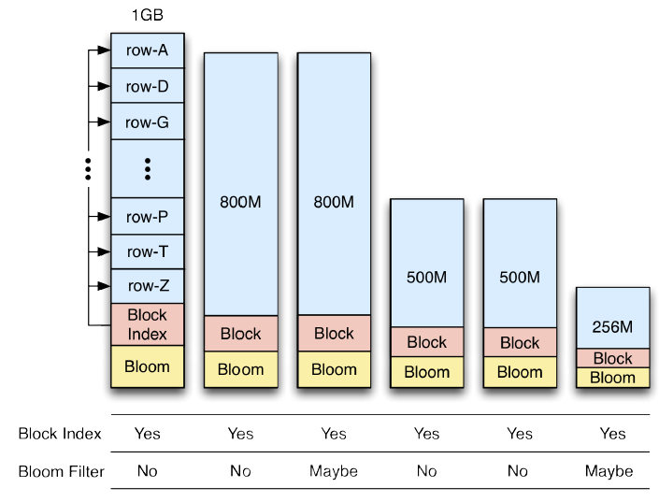
Bloom Filter
Ⅱ. HBASE Techs
Where is that lowkey?
To determine which low key actually exists using the block index, the block must be uploaded to memory and scanned until the key is found (only the block's start low key is stored).
If you activate the Bloom filter, you can immediately know if there is data corresponding to a specific low key (return 'No' or 'Maybe').

Slide 45
Bloom Filter
Ⅱ. HBASE Techs
feature
Activating the Bloom Filter immediately lets you know if there is data corresponding to a particular low key
(Return 'No' or 'Maybe')
It is possible to use the event record, but it is only to delete it.
Good for increasing block cache efficiency
Allows you to reduce search scope by giving time range
option
NONE: Basic settings. If Bloom filter is not useful
ROW: If you want to index only the low key
ROWCOL: To index the row and column keys

Slide 46
operating flow
Ⅱ. HBASE Techs
write operation
Client
Zookeeper
1
2
4
3
HRegionServer
5
6
HRegion
8
WAL Edit
HStore
MemStore
hbase:
meta
...
HBase
7
...
HRegion
Block
Cache
HLog
(WAL)
StoreFile
StoreFile
...
HFile
HFile
9
...
DFS
Client
10
...
Hadoop
DataNode
DataNode
DataNode
DataNode

Slide 47
operating flow
Ⅱ. HBASE Techs
write operation
1
If the client requests to write, the main keeper ensemble (a separate cluster consisting of the main keeper node)
first approach
2
The server information that manages the meta table that contains the row key you want to read through the main keeper
attainability
3
The name of the server that queries the meta table to manage the reversal with the low key that the client finds
Received (the information is cached and retrieved through block cache)
4
Now you can access the HRegionServer that manages the dictionary directly
5
HRegionServer opens a reversal and creates a corresponding HRegion instance.
6
7
The transmitted key / value pair is converted from the reversion server to WALEDIT and is written to the WAL.
8
The data is then stored in the memory store on the memory
9
10
If the data of the memory store exceeds the set maximum value, it is flushed to HFile and distributed to HDFS.

Slide 48
reversal partition
Ⅱ. HBASE Techs
Reverse splitting and Reverse pre-splitting
Perform it on your own on a legacy server
Initially, there is only one reversal in the table, but as the data is added, the system
Monitor not to exceed the maximum set size
The storage file in the reversal is either the hbase.hregion.max.filesize property or by the HColumnDescriptor.
If it is larger than the size set at the column family level, the reversal is split from medium to two
- Creates two leases with approximately the same size
Very quickly, almost instantaneously.
because it is accessed from the original storage file)
Click the 'split' command or the 'split' button on the management web to execute it manually.
dictionary pre-partition
You can set the number of reversals to an existing table or a newly created table
Can create a pre-divided table using the split alorism class provided by HBase
HBase org.apache.hadoop.hbase.util.RegionSplitter \ -c 10 testtable -f colfam1
create 'testtable', 'colfam1', \ { SPLITS => ['row-100','row-200','row-300'] }

Slide 49
reversal partition
Ⅱ. HBASE Techs
repetitive segmentation process
1
Creates the 'splits' directory before the parent.
2
Close the original dictionary to disable further requests
3
Build the required file structure inside the 'splits' directory using multiple threads
Prepare a new child dictionary (including a new child dictionary directory and reference file)
4
the fact that the parent reversal has been split and the information about the two new child relocations in the meta table.
update
5
Two child leases are opened in parallel on the same server
(Update meta table to indicate that it is available)
6
Rebuild the saved file of the child dictionary asynchronously as the saved file of the child dictionary
7
The parent dictionary is deleted if there are no more files referencing itself, and in the parent entry in the meta table.
Disappears and all files on the disk are deleted
8
The fact that the repetition is split is notified to the master, and the new repetitions are sent to other servers for load balancing.
Could be a moving target

Slide 50
Legion life cycle
Ⅱ. HBASE Techs
status
status | description
Offiline | The reversal is offline.
Pending Open | A request to open a dictionary has been delivered to the server
Opening | The server is in the process of opening a dictionary
Open | The state where the reversal is opened and fully operational
Pending Close | A request to close a dictionary has been delivered to the server
Closing | The server is performing a rewind close operation
Closed | reversal closed state
Spliting | The server is performing a reversal split operation.
split | Reverse splitting is complete
* Status change is conducted by the master, but sometimes it is performed on the reversal server that manages the reversal.

Slide 51
Compaction
Ⅱ. HBASE Techs
main compaction and subcompaction
main compaction
Rewrite all the files that make up one column family in one dictionary as a new file
Perform the operation
Data with deletion mark (tombstone marker) can be removed.
Deletes an expired value based on the set data hold time, or there are too many versions in the cell
Can delete old version
Call the ‘ major _ compact ’ cell command or the ‘ majorCompact () API for forced execution.
Verify that the main compilation is performed based on the default value of 7 days (can be changed)
subcompaction
The content of a small file that makes up one column family in one dictionary is smaller,
Reduce the number of storage files by rewriting larger files

Slide 52
Compaction
Ⅱ. HBASE Techs
feature
Which compaction will be performed is automatically determined upon checking the compaction status.
Compact time is determined according to file capacity and number
hbase.hstore.compaction.ratio | Ratio used for compaction file selection algorithm (default 1.2)
hbase.hstore.compaction.min | Minimum number of files to execute compaction (default 2)
hbase.hstore.compaction.max | Number of invitations of files that can be included in the subcompaction (default 10)
hbase.hstore.compaction.min.size | Minimum file capacity that can be a compact target (default hbase.hregion.memstore.flush.size 128mb)
hbase.hstore.compaction.max.size | Maximum file capacity that can be compacted (defalult Long.MAX _ VALUE)
Merging is fast because all the dickers are already arranged in each HFile,
Only affected by disk input / output performance
When consolidated, the consolidated files are moved to the archive folder and deleted after a certain period of time.
If the minimum value (number, capacity) is set to too large, more resources are needed to perform the compaction,
time-consuming
After performing the compaction, a background thread (CompactionChecker) can perform an instance on each reversal server.
operability
This thread performs a regular check operation, and hbase.server.thread.wakefrequency
controllable by attribute

Slide 53
Compaction
Ⅱ. HBASE Techs
SIZE(MB)
1000
750
hbase.hregion.memstore.flush.size = 128MB
500
250
HF1
0
TIME
Older
Newer

Slide 54
Compaction
Ⅱ. HBASE Techs
SIZE(MB)
1000
750
500
250
HF2
HF1
0
TIME
Older
Newer

Slide 55
Compaction
Ⅱ. HBASE Techs
SIZE(MB)
1000
hbase.hstore.compaction.max = 10
hbase.hstore.compaction.min = 3
750
main compaction execution
500
250
HF2
HF1
HF3
0
TIME
Older
Newer

Slide 56

Compaction
Ⅱ. HBASE Techs
SIZE(MB)
1000
HF1
HF2
archive
750
Existing files
After moving to the folder
Deleted after a certain time
HF3
500
by running the main compaction
Integration into one file
CF1
250
0
TIME
Older
Newer

Slide 57
Compaction
Ⅱ. HBASE Techs
SIZE(MB)
1000
750
500
CF1
250
HF4
0
TIME
Older
Newer

Slide 58
Compaction
Ⅱ. HBASE Techs
SIZE(MB)
1000
750
500
CF1
250
HF5
HF4
0
TIME
Older
Newer

Slide 59
Compaction
Ⅱ. HBASE Techs
SIZE(MB)
1000
hbase.hstore.compaction.min.size = flush size
hbase.hstore.compaction.ratio = 1.2
750
If CF1 < 1.2 * (HF4 + HF5 + HF6)
main compaction execution
500
120%
HF6
CF1
250
HF5
HF5
HF6
HF4
HF4
0
TIME
Older
Newer

Slide 60
Compaction
Ⅱ. HBASE Techs
SIZE(MB)
1000
CF2
750
500
250
0
TIME
Older
Newer

Slide 61
Compaction
Ⅱ. HBASE Techs
SIZE(MB)
1000
CF2
750
500
250
HF7
0
TIME
Older
Newer

Slide 62
Compaction
Ⅱ. HBASE Techs
SIZE(MB)
1000
CF2
750
500
250
HF8
HF7
0
TIME
Older
Newer

Slide 63
Compaction
Ⅱ. HBASE Techs
SIZE(MB)
CF2 > 1.2 * (HF7 + HF8 + HF9)
subcompaction execution
1000
CF2
750
120%
500
HF9
HF8
250
HF8
HF9
HF7
HF7
0
TIME
Older
Newer

Slide 64
Compaction
Ⅱ. HBASE Techs
SIZE(MB)
1000
by running a sub-compaction
Only files except CF2
Integrated into CF3
CF2
750
500
CF3
250
HF
10
0
TIME
Older
Newer

Slide 65
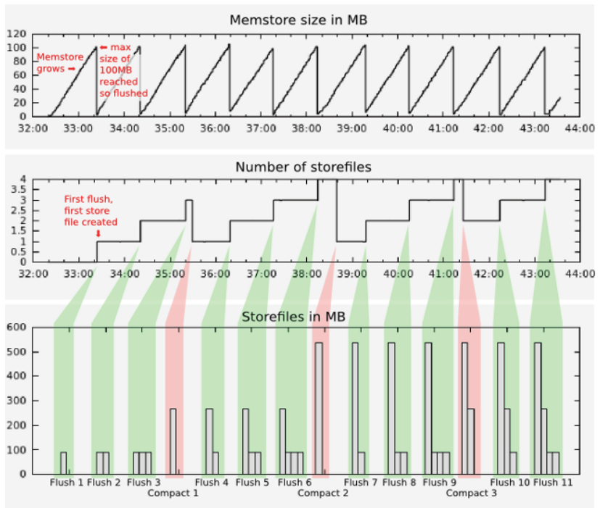
Compaction
Ⅱ. HBASE Techs

Slide 66
Auto Failover
Ⅱ. HBASE Techs
legacy server failover process
3
Notification of failure details
Competition to select a legacy server to divide WAL by league
Zoo
Keeper
4
HBase
Master
2
fault detection
1
reversal server
monitoring
redistribution
6
WAL
fault occurrence
Division of WAL by reversal
5
Region
Server
Region
Server
Region
Server
Region
Server
WAL transmission divided by repetition
Data
Node
Data
Node
Data
Node
Data
Node
6
7
7
7
data recovery
work progress

Slide 67
Auto Failover
Ⅱ. HBASE Techs
Split WAL (Write-Ahead Log) log
1
Split the log what is needed during recovery due to the reversal server down
2
A separate log file is required for each reversal to recover.
3
To classify a group of changes by dictionary
distributed log partitioning system
Increase speed by distributing partitions using the main keeper
If the master registers the log with the jukekeeper, the league servers compete.
Perform split operations on the selected legacy server
When the split operation is complete, the generated file is moved to the actual redirection directory

Slide 68
Balancer
Ⅱ. HBASE Techs
feature
embedded module on the master server
hbase.balancer period - 5 minutes default
Perform tasks that uniformly adjust the number of repetitions assigned to each repetition server
Create a allocation plan, and call the unassign () method to perform a replay move operation in each league
Set the status activation using the balance _ switch command of the shell or the balanceSwitch () method of the api.
Balancer () method of shell balancer or api
Check if you need to perform a balancing operation, and return true if present

Slide 69
Replication
Ⅱ. HBASE Techs
feature
Means for replicating data between HBase systems
Record the query that occurred in the master DB in binlog and stack it in relay log in the slave DB
How those queries are applied
Used to build Disaster Recovery (DR) system
The basic architecture works with master-push method (similar to MySQL master / slave replication)
- The entire WALEdit (the multiple cell input commands included in the write and delete of the client are intact)
replication
You can replicate from one master cluster to any number of slave clusters,
Perform the task of replicating changes by each of the reversal servers
Asynchronous execution
The WAL (HLog) of each repetition server is the basis of the Replication of HBase. In the slave cluster,
It must remain in HDFS as long as it is necessary for data replication
requirements
Each cluster must be able to connect to all other hosts
The major versions of HBase and Hadoop should be the same
The same table with schema, column family must exist

Slide 70
Replication
Ⅱ. HBASE Techs
process
1
If you pass commands such as write, clear, and increment counters to the reversal server, the key / value pair will be used by the reversal server
Converted to WALEdit
2
WALEdit is checked by the Replication Management Module and is used for each column family to be replicated.
Added to the queue for replication
- The column family to be replicated is the replication _ scope.=Set to GLOBAL
3
The UUID of the master is tagged on WALEdit and added to the replication buffer
4
When the buffer is full, it is randomly transmitted to the legacy server of the slave cluster
- The reversion server of the slave cluster to be transmitted is selected according to the specified ratio.
(ex. slave cluster server (150 units) * ratio (10%)=15 generations)
5
When the reversal server receives the changes, it reads them sequentially, and then the table
Saved in a separate buffer
6
Flush these buffers once all changes have been saved to the buffer

Slide 71
Replication
Ⅱ. HBASE Techs
reference
When replicating existing data
Start replication and record timestamp
Use the copy table command to specify the end timestamp as a timestamp that has been recorded before.
We proceed with the entire copy until there
replication data verification
Perform the VerifyReplication MapReduce job in the master cluster.
Hadoop jar $HBASE_HOME/hbase-<version>.jar verufyrep [--starttime=timestamp1]
[-stoptime=timestamp2][--families=comma separated list of families]<peerId>
<tablename>

Slide 72
HBase Snapshot
Ⅱ. HBASE Techs
feature
It allows you to take a snapshot of a table without a lot of load on the dictionary server.
Sending snapshots to other clusters also does not load the legacy server
Snapshots do not include replication of data
Activated after HBase 0.95 version
CopyTable / ExportTable for backup or table replication in the previous version
Use or disable the table and copy HFile from HDFS.
snapshot ‘ myTable ’, ‘ myTableSnapshot ’ – snapshot shell
colne_snapshot
You can create a new table with the same data from existing snapshots
Not including data replication
Replicated tables do not load snapshots or the original table
clone_snapshot ‘myTableSnapshot’ , ‘myNewTable’

Slide 73
HBase Snapshos
Ⅱ. HBASE Techs
feature
restore_snapshot
Recovered to the state when the snapshot was taken
Table must be disabled
restore_snapshot ‘myTableSnapshot’
exportSnapshot
All data related to snapshots (hfiles, metadata, snapshot metadata) to other clusters
replica box
Copy data between two clusters to Map-Reduce job
bin/hbase class org.apache.hadoop.hbase.snapshot.ExportSnapshot
-snapshot MySnapshot -copy-to hdfs://srv2:8082/hbase -mappers 16
(Exporting MySnapshot to srv2 cluster using 16 mappers)
bin/hbase class org.apache.hadoop.hbase.snapshot.ExportSnapshot
-snapshot MySnapshot -copy-to hdfs://srv2:8082/hbase -mappers 16 -bandwidth 200
(Limiting bandwidth)

Slide 74
Secondary Index
Ⅱ. HBASE Techs
The method managed by the client
Transfer all of the secondary index management to the application layer, managed by the client
The table is used in combination with the data table on the server side.
Auxiliary index table information each time a client enters data into a data table
We need to update together
merit
All processes for the secondary index are handled by the client, which requires secondary index key interoperation
It can be implemented freely in any form
disadvantage
transaction processing problem
Can be relaxed by first applying to the secondary index table and then storing it in the data table
If the operation is interrupted during processing, the auxiliary index information that becomes orphaned will remain,
You can clean up the process asynchronously in the periodic pruning operation
All elements needed to store and navigate data must be implemented directly

Slide 75
Secondary Index
Ⅱ. HBASE Techs
Indexed-Transaction HBase(ITHBase)
Expand both client and server classes to add their own implementation
Enhance transaction processing to ensure consistency of all secondary index update operations
Client and server classes are replaced by classes that support indexing (HTable - > IndexedTable).
The interworking information between the main index and the secondary index is stored in a separate table.
Created and managed
Combine these indexes with transaction functions to provide a secondary index for complete HBase.

Slide 76
Secondary Index
Ⅱ. HBASE Techs
Indexed HBase(IHBase)
Manages indexes in memory without storing them in a separate table
The index is generated when the replay is first opened or when the memstore is emptied to the disk,
Build an index by scanning the entire reversal data
It may take quite a long time to build an index, depending on the resize setting
It also uses a lot of input / output resources.
merit
There is no concern that the synchronization of the index will break and explicit transaction control is unnecessary
Very fast compared to table-based indexes
disadvantage
A very large heap space is required to store index information
Installation cost hassle (client and server side classes that require and require separate JAR files
You must add a setting to change the feature.)
Additional resources are required
The latest version of HBase may not be available

Slide 77
coprocessor
Ⅱ. HBASE Techs
feature
A method for causing a portion of a computational task to be processed on a server on which data is stored (a small membership framework).
Allow arbitrary code to run directly on each legacy server
Create a Java class that implements a specific interface and provide it as a jar file.
It is developed by applying Google Big Table as a motif to HBase.
The function is powerful, but there is a risk
usage
Manage row change operations to manage secondary indexes, or use some kind of reference integrity
implementation work
Aggregate functions such as sum () or avg () also move to the server side to scan data locally
Aggregate operations can be processed to allow the network to transmit only one result numeric value
form
System coprocessor
Loads to Legends of All Tables and Legends Server
Table coprocessor
Loads to all leases in the table

Slide 78
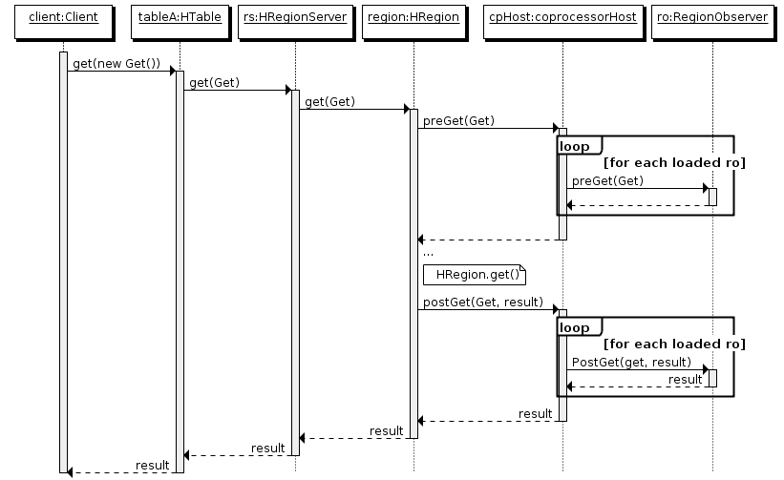
coprocessor
Ⅱ. HBASE Techs
Framework – Observer
When a specific event occurs, you can specify a callback method (hook) by preprocessing and post-processing (similar to trigger).
Provides a well-defined event callback method for all actions performed by the cluster server
Twitter is used to match the sync of different tables to some extent
It has a recursive effect, so HBase cluster may die.

Slide 79
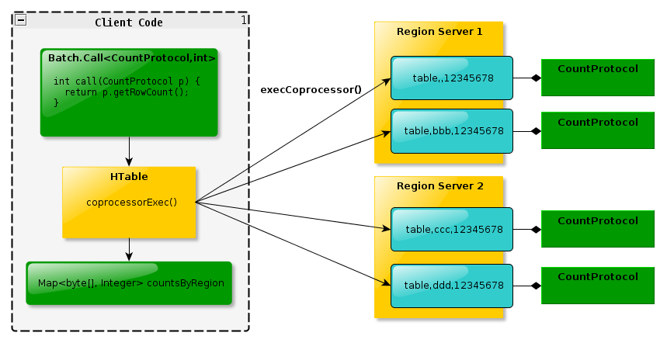
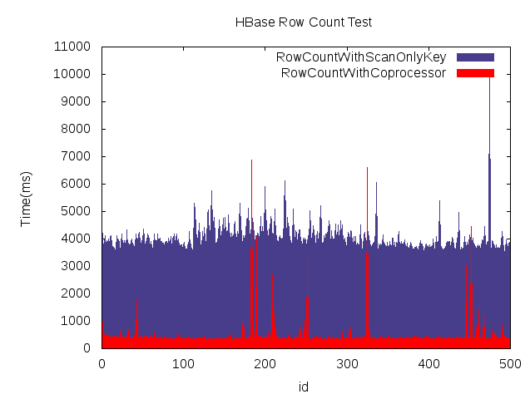
coprocessor
Ⅱ. HBASE Techs
Framework – endpoint
Using the HBase RPC, the client remotely passes the command to the target lease and executes the result
Structure that the client collects when it returns
Concepts such as the Stored Procedure of Relational Database Management Systems
1
Through a method called Batch.Call,
Deliver what needs to be done.
 | MR Row Count | EndPoint Row Count
Number of Row | 200 million cases | 500 million.
time | 129 minutes | 51 minutes
2
Each dictionary has the same code processor implication
Perform work through
3
The work result is shown in map of endpoint < before, result >
is returned, and this is collected

Slide 80
Introduction to HBASE
HBase Techs
Operation and management of HBase
HBase Monitoring
HBase Performance

Slide 81
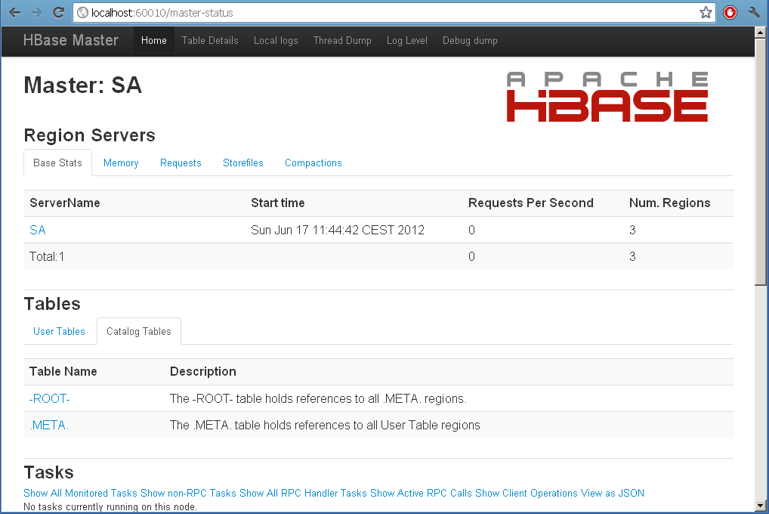
Web-based management console
Ⅲ. Operation and management of HBASE
Master UI & Region server UI
master UI
60010 ports of devices where the master server is located
Master Attributes
Attribute values applied to cluster construction
User Tables
All managed in HBase cluster
table information
split, compact executable
Region servers
a legacy server managed by the master, and
Retrieving Details
Catalog Tables, Region in Transaction 등
reversal server UI
60030 ports of devices where the reversal server is located
Region Server Attributes
HBase version, compiled point of view, etc.
Online Regions
On the Leon server you are currently looking at
Show all repetitions you manage

Slide 82
Node Decommission
Ⅲ. Operation and management of HBASE
./bin/hbase-daemon.sh stop regionserver
process
Close all open leases and discontinue the process on your own
If the process stops, the temporary node of the main keeper corresponding to this reversion server will expire.
The master recognizes this and considers the reversal server to be discontinued.
Re-allocate the reversion managed by the reversal server to other servers
constraint
The balancer needs to be inactive before performing node decomposition
Recovery of failures in the valencer and master when the balancer operates while the node is being stopped
Work conflict can occur between mechanisms (balance _ switch false)
disadvantage
The reversal is disabled for a set period of time with the main keeper timeout cycle.
Legends are closed in a certain order. If the Legends server has a very large number of legends,
After the rest of the league is closed, the master is the main keeper Z node of the league server
It waits closed until it realizes it has been deleted.

Slide 83
Node Decommission
Ⅲ. Operation and management of HBASE
. / bin / graceful _ stop.sh Reset server host name
The ability to gradually release the reversal from the node and to interrupt the process by itself
process
Extract a reversion one at a time from the server
When moving a reversal, make sure that it is well placed in a new location and process the next replay
Repeat this process until there are no more repetitions left on the server to be decommissioned
At the end of this process, command the reversal server to stop the process
Since all relocations have already been relocated, perform additional tasks such as splitting the WAL
Work completed without need

Slide 84
stepwise restart
Ⅲ. Operation and management of HBASE
process
Execute the ‘ hbck ’ command to check the consistency of the cluster
./bin/hbase hbck
Restart master server
./bin/hbase-daemon.sh stop master; ./bin/hbase-daemon.sh start master
Disable the balance of the reversal
echo "balance-switch false" | ./bin/hbase shell
Execute the 'graceful _ stop.sh' script on all repetition servers.
for i in 'cat conf/regionservers|sort'; do ./bin/graceful_stop.sh \ --restart --reload
--debug $i; done &> /tmp/log.txt &
Master Server Restart Again
The dead servers will be removed from the list of before servers and the load balancer will be reactivated.
Execute 'hbck consistency again to check cluster consistency

Slide 85
Add Server
Ⅲ. Operation and management of HBASE
Add reversal server
Regionsarchive files in the conf directory must be modified
Add the host name of the legacy server you want to add
How to Activate a New Leon Server Process
Run start-hbase.sh script on device where master server is located
Whether the process is already running on that device before executing the process enable command
Check, skip the operation command for the server that passed the test
./bin/hbase-daemon.sh start regionserver
You must run it directly on the device you want to start a new reversal server
When the legacy server process starts, it creates a Z node with its own host name
Registered himself as a jukekeeper and assigned a dictionary

Slide 86
Add Server
Ⅲ. Operation and management of HBASE
Add backup master
The master process uses the main keeper to determine which master process is the main master.
./bin/hbase-daemon.sh start master --backup
Can be set to backup-masters file in conf directory
When the name is registered, the backup switch is automatically added when the master server process is started
When running the start-hbase.sh script, first start the main master server and start the reversion server
The next last time you start a backup master
You can run the backup master server by running the hbase-backup.sh script directly.
reference
There's a dedicated Z node on the jockey that all the master processes compete to create,
The master process that first created this Z node becomes the main master

Slide 87
data job
Ⅲ. Operation and management of HBASE
export
parameter
parameter | description
tablename | Name of the table where you want to export data
outputdir | HDFS location where the exported data will be stored
versions | Number of versions to export per column, default value 1
starttime | Start time of the timestamp for the version to be exported per column
endtime | The end time of the time range to use in the scan
regexp/prefix | If you start with ^, it is recognized as a regular expression pattern and is matched to the low key. If you do not start with ^, it is recognized as a low-key prefix.
The tablename and outputdir parameters are required
Parameters must be specified in the order in the table above, and missing parameters should not be present in the middle.
hadoop jar $HBASE_HOME/hbase-<version>-SNAPSHOT.jar export \ testable
/user/larsgeorge/backup-testtable

Slide 88
data job
Ⅲ. Operation and management of HBASE
import
parameter
parameter | description
tablename | Name of the table to import the data
inputdir | Directory where the file from which the data export was performed is located
versions | Number of versions to export per column, default value 1
starttime | Start time of the timestamp for the version to be exported per column
endtime | The end time of the time range to use in the scan
regexp/prefix | If you start with ^, it is recognized as a regular expression pattern and is matched to the low key. If you do not start with ^, it is recognized as a low-key prefix.
Perform as opposed to the export operation
hadoop jar $HBASE_HOME/hbase-<version>-SNAPSHOT.jar import \ testable
/user/larsgeorge/backup-testtable

Slide 89
data job
Ⅲ. Operation and management of HBASE
Mass Import and Table Replication Tools
importtsv tool
Tap-delimited data format TSV files from the Large Data Import tool for HBase
It can be used as a source.
Enter one row at a time using the put () API of HBase.
hadoop jar $HBASE_HOME/hbase-<version>-SNAPSHOT.jar importtsv
-Dimporttsv.columnns=a,b,c <tablename> <inputdir>
Imtsv.bulk.output options allow you to create files using HFileOutputFormat
presence
heebulkload tool
Import a large amount of files generated by importtsv into the cluster.
The -conf < configuration file > parameter is used to specify a file that stores the HBase parameter.
If HBase does not manage the main keeper directly, the main keeper setting file is located in this path
Include directories
hadoop jar $HBASE_HOME/hbase-<version>-SNAPSHOT.jar completebulkload \ -conf
-my-hbase-site.xml /user/larsgeorge/myoutput mytable
table replication tool
Replicates a table in the master cluster as a slave cluster
hadoop jar $HBASE_HOME/hbase-<version>-SNAPSHOT.jar copytable \
-new.name=testtable3 testtable

Slide 90
cluster problem solving
Ⅲ. Operation and management of HBASE
HBaseFsck(hbck)
When the hbck tool is executed, the root directory of HBase set in meta table and HDFS is scanned
Get necessary information
consistency check
Perform reversal as a whole
Check if the reversal is registered in the meta table and actually exists in HDFS
Check if it is assigned to exactly one reversal server
integrity test
Perform the table as a whole.
Compare each repetition to the table specification to see if there is a missing repetition and a hole in the low key range
Check if there are overlapping parts
If the fix option is used, the problem found through such inspection is solved as much as possible.
Assignment to one new server if meta table is not assigned
If the meta table is assigned to more than one server, then reassign to one new server
Assignment to one new server if no redirection of the user table is assigned
If the redirection of the user table is assigned to more than one server, reallocate to one new server
If the reversion of the user table differs from the server currently assigned to the meta table, then one
Re-allocate to a new server

Slide 91
Introduction to HBASE
HBase Techs
Operation and management of HBase
HBase Monitoring
HBase Performance

Slide 92
monitoring
Ⅳ. HBASE Monitoring
ganglia
ganglia monitoring daemon
It must be executed on all devices subject to monitoring
Collect local data and prepare statistics information to propagate to other systems
Network in unicast or multicast fashion by monitoring changes in the device
message scattering
gmetad
The role of federation nodes for all clusters installed in the central node
polling one or more monitoring daemon to receive cluster current status
Saved in the RRDtool (time continuous database of round robin type)
Collects the values calculated by the monitoring daemon active in each node.
Ganglia PHP Web Front End
Web Front-End Provided by Ganglia
Receives the statistics collected by the meta daemon and displays it in HTML form.
Use the RRDtool to graph the stored time continuous data.

Slide 93
monitoring
Ⅳ. HBASE Monitoring
Ganglia Data Flow
gmond
gmetad
/etc/gmond.conf
/etc/gmetad.conf
gmond
RRDTOOL
/etc/gmond.conf
gmond
PHP scripts
/etc/gmond.conf
Apache2
+ PHP
Browser

Slide 94
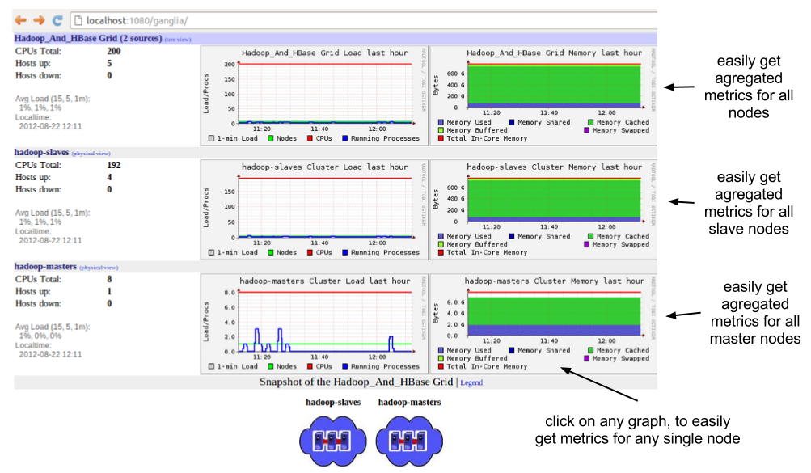
monitoring
Ⅳ. HBASE Monitoring
ganglia
Hadoop Cluster monitoring.
a very useful open source
monitoring tool
from the nodes in the cluster
monitoring performance indicators,
integrated control function
offer
memory, CPU, disk,
as well as network usage,
Only a few installations / settings
more than 200 pieces of metric information
Monitor

Slide 95
monitoring
Ⅳ. HBASE Monitoring
Canary
region mode
Legion requests one row per column family and provides information about failure and delay time
region server mode
The legacy server requests one row from one randomly selected table, and the failure
Providing information about delay time
It can be used in conjunction with monitoring tools such as Nagios
daemon mode
/bin/hbase org.apache.hadoop.hbase.tool.Canary – daemon
Interval 6 seconds, stop when you find an error.
/bin/hbase org.apache.hadoop.hbase.tool.Canary – daemon –interval 5 –f false
Interval 5 seconds.

Slide 96
monitoring
Ⅳ. HBASE Monitoring
Nagios
A very widely used support tool for collecting static data about cluster status.
Nagios and HBase are commonly interoperated using JMX.
function
Network service monitoring (SMTP, POP3, HTTP, NNTP, PING, etc.)
Host resource monitoring (processor load, disk usage, etc.)
A simple plug-in design that makes it easy to develop plug-ins to check their services
parallelized service check
Notify when a service or host problem occurs or is resolved (email, SMS, custom method)
Define event handlers to be executed upon pre-troubleshooting of service or host events
automatic log file cycle
Monitoring host redundancy support
Optional Web interface to view current network status, notification and problem history, log files, etc.

Slide 97
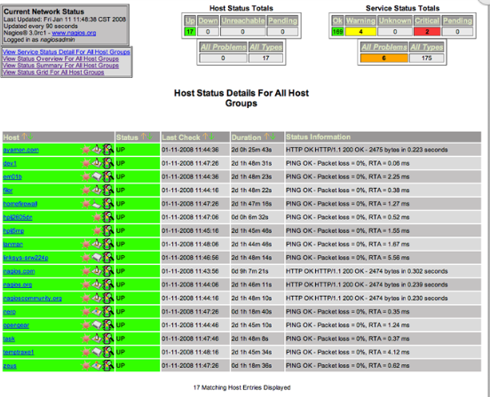
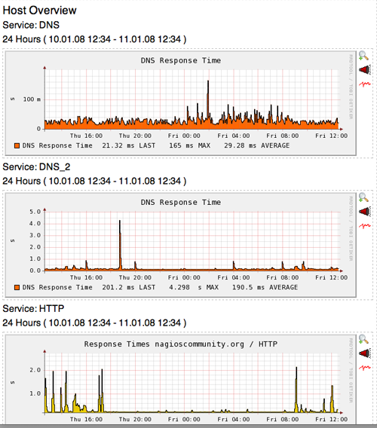
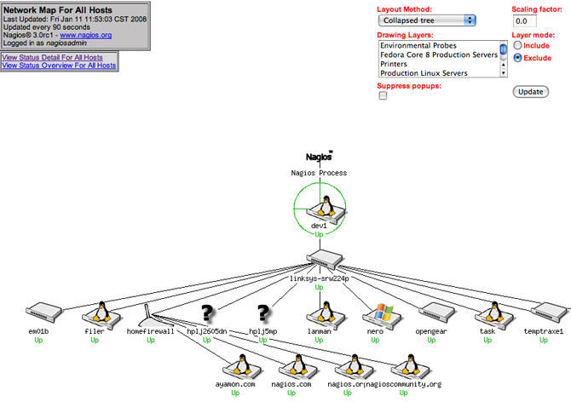
monitoring
Ⅳ. HBASE Monitoring
Nagios
host detail information
PNP Addon graph
host network tree map

Slide 98
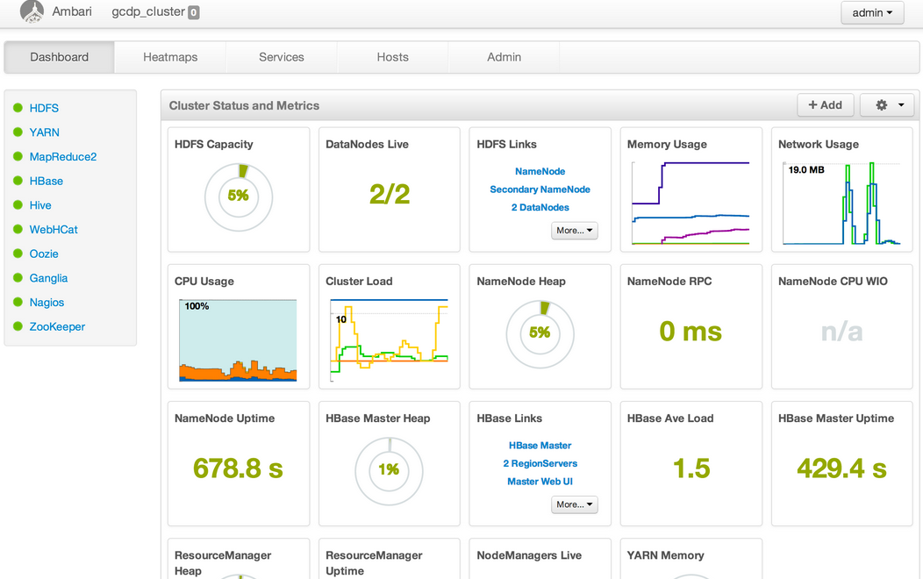
monitoring
Ⅳ. HBASE Monitoring
Ambari

Slide 99
Introduction to HBASE
HBase Techs
Operation and management of HBase
HBase Monitoring
HBase Performance

Slide 100
Memstore Local Allocation Buffer (MSLAB)
Ⅴ. HBASE performance
feature
Reducing heap fragmentation caused by complex behavior of a reformer server's memstore instance
To allocate only objects of the same size to a heap at all times
Garbage collection does not occur
When these objects are moved or deleted into the old generation heap, they create a certain size of empty space
the new assigned objects are all of the same size objects, so always this empty
Reuse of space
It is activated by default
Whether to enable - hbase.hregion.memstore.mslab.enabled property
MSLAB size -hbase.hregion.memstore.mslab.chunk size property (default value 2MB)
Maximum storage size - hbase.hregion.memstore.mslab.max.allocation attribute (default value 256KB)

Slide 101
garbage collection
Ⅴ. HBASE performance
feature
Need hip-size control to optimize performance
The old generation heap is too fast because of the task of transferring surviving objects to the old hips.
It is necessary to make enough size of young generation heap so that it is not fragmented
But when it gets too big, the process stops too often for a short period of time,
Server response time may be longer
If the time when the process stops with gc exceeds the value set as the main keeper session timeout,
The master considers this process to have disappeared and excludes it from the cluster
Even if the status is normalized, this process is notified from the master that it is excluded from the cluster.
It ends the process by itself.

Slide 102
compression
Ⅴ. HBASE performance
feature
In most cases, it is recommended to use it by showing better overall performance when compressing data
The CPU overhead that performs compression and decompression needs to read more data from disk
Because it is less than overhead
compression algorithm
snapy
Provide rapid speed with smooth extrusion rate
LZO
A lossless data compression algorithm focusing on decompression rate
GZIP
The compression rate is good, but the speed is slow.
Lots of CPU resource consumption
Specifies the compression algorithm you want to use for the column family schema
create 'testtable', { NAME => 'colfam1', COMPRESSION => 'GZ' }

Slide 103
Performance improvement setting recommendation plan
Ⅴ. HBASE performance
reference
Reduce the time out cycle of the main keeper
The default value is 3 minutes (zookeeper.session.timeout).
Reduce timeout settings to make the master aware of the reversal server shutdown sooner (consider gc time)
handler extension
Number of threads to keep waiting to respond to requests for user tables
hbase.regionserver.handler.count(기본값 10)
If the amount of data transmitted per request reaches several megabytes, it is better to keep it low,
It is better to set it high if it is small.
heap size increase
If you want to allocate 8GB or more memory to HBase, in the hbase-env.sh file,
HBASE _ HEAPSIZE environment variable must be changed
data compression activation
Snaffina LZO algorithm used

Slide 104
Performance improvement setting recommendation plan
Ⅴ. HBASE performance
reference
resizing
The default size is 256 MB - 1 GB or more.
Cluster works more smoothly when the number of repetitions is low
Properties of hbase.hregion.max.filesize in hbase-site.xml settings file
recombination
When you need to reduce the number of repetitions managed by each server by deleting a large amount of data
hbase org.apache.hadoop.hbase.util.Merge <table-name> <region-1> <region-2>

